Slide 1
Strengthening of the European inland waterway transportation in the Baltic Sea Region: the INTERREG project EMMA
Stefan Breitenbach
Head of Project Department
Port of Hamburg Marketing e.V.

Slide 2
Agenda
Background of the project application „EMMA”
The EMMA project in details
Pilot activities and benefits

Slide 3
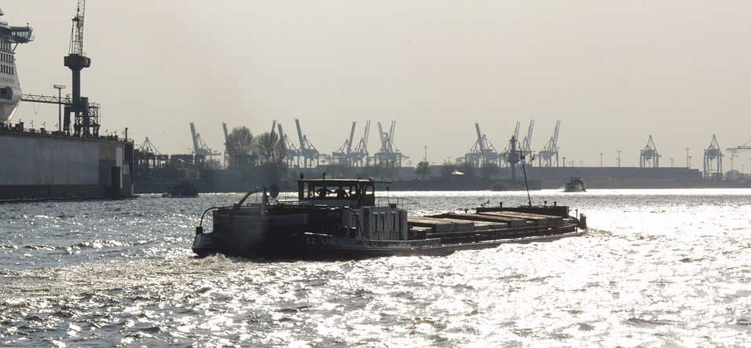
Two central questions before each journey:
At what time will I reach the destination?
Are there any barriers or congestions…
What is the maximum draught?
How much load can the vessel carry…
Notes:
AIS- Daten werden bisher nicht für Binnenschiffe ausgewertet oder gespeichert.
AIS-Daten sind nur für die Nutzung zu Sicherheitsaspekten vorgesehen
Nicht alle Binnenschiffe nutzen AIS
Radardaten werden bisher nicht in Hinblick auf Binnenschiffe ausgewertet und nicht gespeichert.
Es findet eine manuelle /qualitative und Fragestellung bezogene Erfassung durch Befahrungen statt.
Eine Auswertung erfolgt nur im Rahmen der Daten des Statistikamtes Nord und in Form von Hochrechnungen im Rahmen von Gutachten (z.B. Modal Split Prognose, Umschlagspotentialprognose.

Slide 4
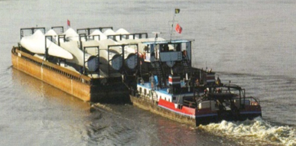
Challenges for Inland Waterway Transportation
Integration of inland waterway transportation (IWT) in supply chains must be optimised.
Investment and innovation backlog
Forced lobbying by creating a strong network in the canal and Elbe area
Installation and support of digitalisation and telematics network!
Fund requests
ITS-Strategy IWT
Initiatives of industry partners
Support of innovation and investment willingness!
Notes:
AIS Infrastruktúr
HVCC → FLZ
Schleusewartezeitprognosen
Reduktion der Umschlagskosten für Binnenschifffe
Alternative Kraftstoffe

Slide 5
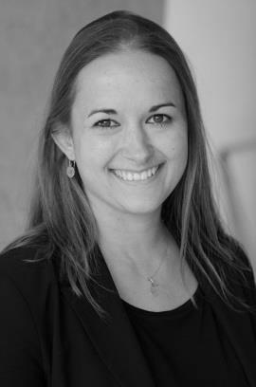
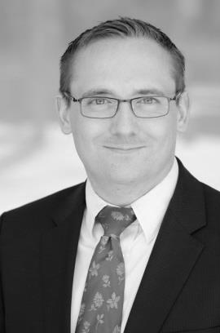
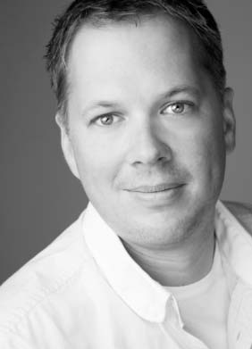
The EMMA project
Lead Partner Hafen Hamburg Marketing e.V. Pickhuben 6 – 20457 Hamburg Germany
Adina Cailliaux cailliaux@hafen-hamburg.de Tel: +49 (0)40 37709 - 172 | Stefan Breitenbach breitenbach@hafen-hamburg.de Tel: +49 (0)40 37709 – 121
Project Coordination and Finance PLANCO Consulting GmbH Am Waldthausenpark 11 - 45127 Essen Germany
Gunnar Platz gp@planco.de Tel: +49-(0)201-43771-14

Slide 6
The EMMA project
Aims of the project
Strengthening of inland waterway and coastal transportation in public perception (image)
Promotion of better integration of inland waterway and coastal transportation in transport chains of the Baltic Sea Region as well as in EU strategies
Investigation of regional challenges that hinder better integration of the inland vessel in transport concepts/chains
Development of solution approaches
Promotion of cooperation between separate interest groups (organisations and association)
Enhancement of the modal split in the Baltic Sea Region

Slide 7
The EMMA project
Aims of the project
Identification of potential consignors and investigation of their needs
Analysis and suggestion of new services in order to integrate IWT into supply chains
Proof of feasibility and possibilities of IWT due to pilot actions
Improvement of IWT competitiveness in the BSR
Tackling of administrative and regulatory barriers
Supplying IWT with a stronger voice and better standing in policy and society
Possibility for a real change and long-term impact of results due to a holistic approach
Support of MS in reaching the binding legislation on GHGs emissions targets (EU2020 climate & energy package)
Notes:
EMMA will identify industries which could make use of IWT and customer needs towards an integration of IWT into their supply chains. Based on this EMMA will analyses and suggest new services and promote same to potential shippers. This includes market studies and IWT service implementation guidelines.
Four pilot actions will prove feasibility and possibilities of IWT in the BSR (Pilot in Lithuania: Heavy cargo service line in Lithuania, connecting the Port of Klaipeda with its hinterland).
EMMA will improve competitiveness of IWT in the BSR
EMMA tackles administrative and regulatory barriers hindering IWT development in the BSR to strengthen the future development of IWT in the BSR.
EMMA will give IWT a stronger voice and better standing in policy and society, by:
Foster a stronger cooperation of existing IWT lobby organizations in the BSR to form a common voice.
Foster a stronger cooperation of BSR Short Sea Shipping Promotion Centers (SPCs). Stabilise SPCs structures in the BSR and extend their focus to IWT
Setting up of IWT information and dialogue fora for policy and administration to bring IWT into politicians’ mind and to (in the long-run) change their mind-set.
EMMA stands for a holistic approach, which includes regional and national administration, policy and industry level, which sets the possibility for a real change and long term impact of results.
By strengthening IWT EMMA will support MS in reaching the binding legislation on GHGs emissions targets (EU2020 climate & energy package)

Slide 8
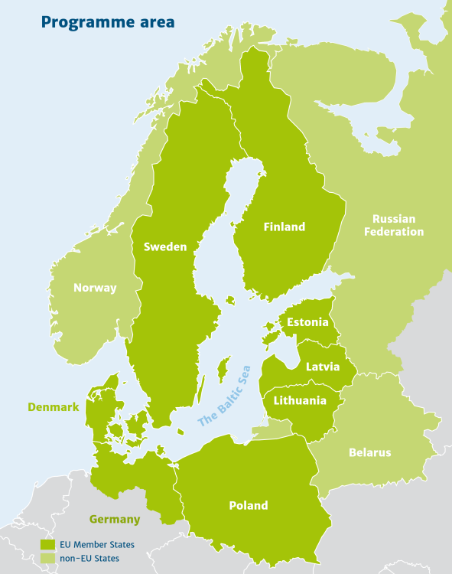
The EMMA project
21 project partners from 5 countries
Sweden
Finland
Lithuania
Germany
Poland
Notes:
Projekt im BSRP platziert
Projektvolumen rund 4,

Slide 9
The EMMA project
48 associated partners from 8 countries
Chambers of Commerce & regional authorities
Organisations and associations
National ministries
Inland Ports
Federal Ministry of Transport and Digital Infrastructure (DEU)
Lithuanian Maritime Safety Administration
Ministry of Transport and Communication of the Republic of Lithuania
Swedish Transport Agency
Finnish Transport Agency
Behörde für Wirtschaft, Verkehr und Innovation der Freien und Hansestadt Hamburg
Chamber of Commerce Mälardalen (FI)
Flanders´ Institute for Mobility
Häme Chamber of Commerce
Industrie und Handelskammer Lüneburg Wolfsburg
Regional Water Management Authority Gdansk (PL)
East West Transport Corridor Association
Elbe Allianz e.V.
European RiverSeaTransport Union e.V.
Swedish Shipowners´ Association
Association for European Inland Navigation and Waterways
Association for Promotion of the Oder/Havel River Basins
Weitblick Verkehrsinfrastruktur, Wirtschaft und Logistik e.V.
European Barge Union (EBU)
School of Business and Management of Technology of the Belarussian State University
Association of Polish Regions of Baltic Adriatic Transport Corridor
Inland Navigation Europe
Lithuanian lntermodal Transport Technology Platform (LITTP)
Süderelbe AG
ShortSeaShipping Inland Waterway Promotion Center Germany
Shortsea Promotion Centre (SPC) Finland
Hafenbetriebsgesellschaft Eisenhüttenstadt mbH
HTAG Häfen und Transport AG
Ports of Stockholm
Schwedter Hafen
Saimaa Ports Joensuu
Port Authority of Södertälje
Hamburg Port Authority AöR
LUTRA Lager Umschlag Transport
Mittelbrandenburgische Hafengesellschaft mbH
Ministry of Economy, Transport and Innovation of the Free and Hanseatic City of Hamburg
Chamber of Commerce Mälardalen (FI)
Flanders´ Institute for Mobility
Häme Chamber of Commerce
Chamber of Industry and Commerce Lüneburg Wolfsburg
Regional Water Management Authority Gdansk (PL)
Shipping companies
BKS Binnenschiffahrtskontor Sommerfeld GmbH
Deutsche Binnenreederei AG
Reederei Ed Line GmbH
VT Shipping Company
Walter Lauk Ewerführerei Ltd.
Zegluga Bydgoska Sp. z.o.o.
Industry
PCC Intermodal S.A.
SIEMENS AG WP ON LOG LS
Technische Werke Schwedt GmbH

Slide 10
The EMMA project
Work packages and key aspects
Enhancement of Competitiveness
Analysis of efficient transport concepts and their transferability on the Baltic Sea Region (best practices)
Development of the „Competitive Improvement Plans“
Pilot practices to enhance the modal split
Reduction of bureaucratic and regulatory restraints
Analysis and recommendations regarding administrative structures in separate countries
Analysis and recommendations regarding political decision-making processes in the Baltic Sea Region and the EU
Potential raising
Identification of potential consignors and investigation of their needs
Application of best practices and planning of transport chains (market development)
Results communication (fair attendance)
Strengthening of inland waterway and coastal transportation in public
Analysis, assessment and strengthening of lobby structures in the Baltic Sea Region (organisations, associations, SPCs)
Work groups (industry | organisations and associations)
Public relations activities (visiting groups in inland ports)
Notes:
Competitive Improvement Plan:
Bottleneck analyses and potentials for IWT,
IT solutions (Elbstromgebiet, Saimma canal),
Existing Fleet and characteristics
Best Practices
Pilot Cases (Finland: ice, Lithuania: oversize cargo, Poland: Multimodal port study, Sweden: ship design and Swedish IWT framework, Germany: ICT Solution)

Slide 11
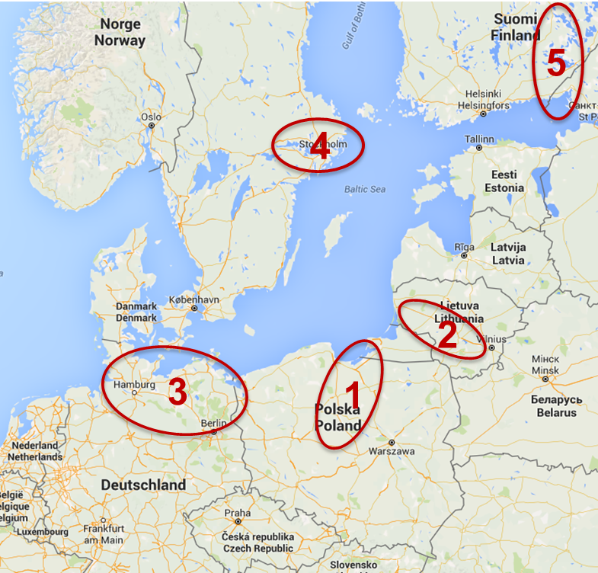
The EMMA project
Pilot practices and demonstrators
Poland – Gdańsk (the river Vistula)
Feasibility study regarding the inland supply chain
Transport chains from the Port of Gdańsk to the hinterland
Lithuania – Klaipėda (the river Neman)
Heavy goods transportation connection from the Port of Klaipėda to the hinterland
Germany (North German river basin)
Digital map with status information on inland waterways
Sweden - Stockholm (Lake Mälaren)
„Dynamic Zone Management System“ & transport shift from road to inland waterways
Finland – North Karelia (Saimaa Canal & Lake Area)
Information systems for transport optimisation of timber products via inland waterways
Notes:
Poland: Feasibility study regarding the inland supply chain navigation from the Port of Gdańsk to the hinterland
An account of current hydrotechnical conditions on the river Vistula
A container inland shuttle from Gdańsk to Warsaw
The use of modern inland ports
Lithuania: Oversize and heavy cargo service line using rivers and cross water barriers
Bridges sections are designing and constructed for the section maximum weight up to 200 tons, which is not enough for the heavy cargo transportation. For the optimize transportations of the heavy oversize cargo it is necessary provide investigations and prepare solutions
Germany: Digital map with status information on inland waterways in Northern Germany
Focus: Northern German Waterways (e.g. Mittelelandkanal, Elbe-Lateral Canal, River Elbe and Weser, Berliner Kanalgebiet)
Information for shippers
Operating hours
Ship positions and traffic density information
…additional RIS services possible.
Sweden:
o Pilot I = Study on ship transferability assessment
The study will be conducted by the Swedish newly started IWW-specialized, shipping company AWT AB, in cooperation with European actors in:
Ship construction, Inland waterway barging, Classification societies, Other shipping companies, Ship equipment suppliers
→ The study will identify 1-3 vessels suitable for Swedish purposes, and use these as use-cases for the study
o Pilot II = Distribution on inland waterways within the Stockholm & lake Mälaren region
The pilot aims to investigate whether it is possible to shift the distribution of liquid fuels, construction and recycling products from the today on road tansportation to a sea- based logistics solution on the inland waterways of Lake Mälaren.
The pilots main goal is to build a commercial and sustainable distribution model that enables a demonstration of IWW-distribution on Lake Mälaren.
Finland: Information system for transport optimization of timber products via inland waterways
Navigation in Saimaa area is very challenging due to changes in water level (flooding seasons, drought seasons, length of ice season) in very narrow routes that are in highly environmentally valuable waterways.
Possible solutions: Smart navigation system of Saimaa. Smart buoy system / Sensor systems for environment data & transport data /Analysing tools for big data collected, Digitalisation – ICT solutions

Slide 12
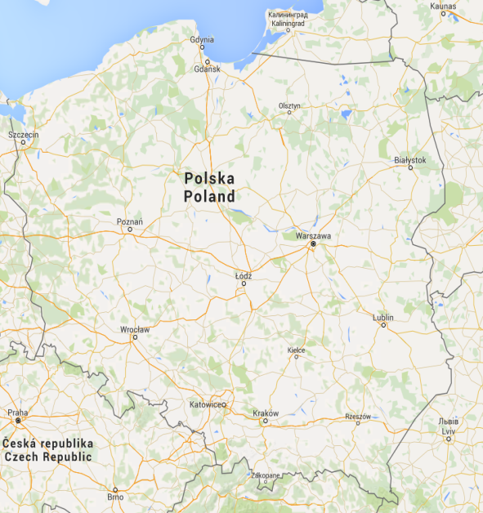
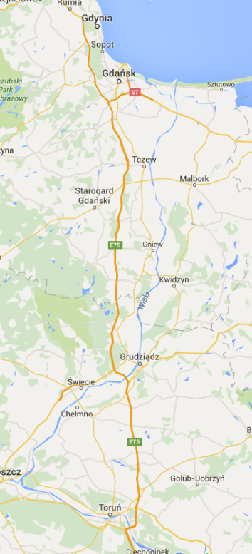
Pilot project 1 – Poland (Gdańsk)
Feasibility study regarding the inland supply chain navigation from the Port of Gdańsk to the hinterland
An account of current hydrotechnical conditions on the river Vistula
A container inland shuttle from Gdańsk to Warsaw
The use of modern inland ports
Notes:
A promotional container barges cruise from Gdańsk to Warszawa
The pilot action relates to the presentation of current hydrotechnical conditions observed on the Vistula river and the possibility of establishing a permanent transport connection between Gdansk and Warszawa based on modern river cargo transshipment ports established along the route located
Ich würde die Graphiken sich durchaus überlappen lassen und animieren (reinzoomen) – dies bezieht sich natürlich auch auf die anderen Piloten.
Dann ist auch mehr Platz für den Text.

Slide 13
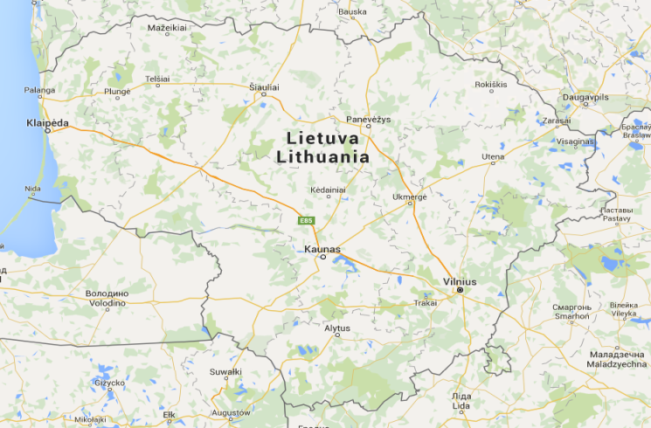
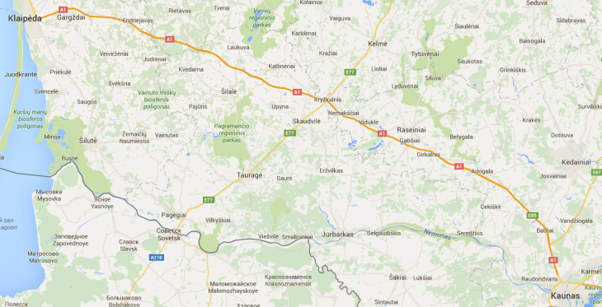
Pilot project 2 - Lithuania
Heavy goods transportation connection from the Port of Klaipėda to the hinterland
Bearing load of many bridges is max. 200 t
Too low for many heavy goods transports
The use of inland waterways would solve the problem.
Notes:
Oversize and heavy cargo service line using rivers and cross water barriers
Bridges sections are designing and constructed for the section maximum weight up to 200 tons, which is not enough for the heavy cargo transportation. For the optimize transportations of the heavy oversize cargo it is necessary provide investigations and prepare solutions

Slide 14
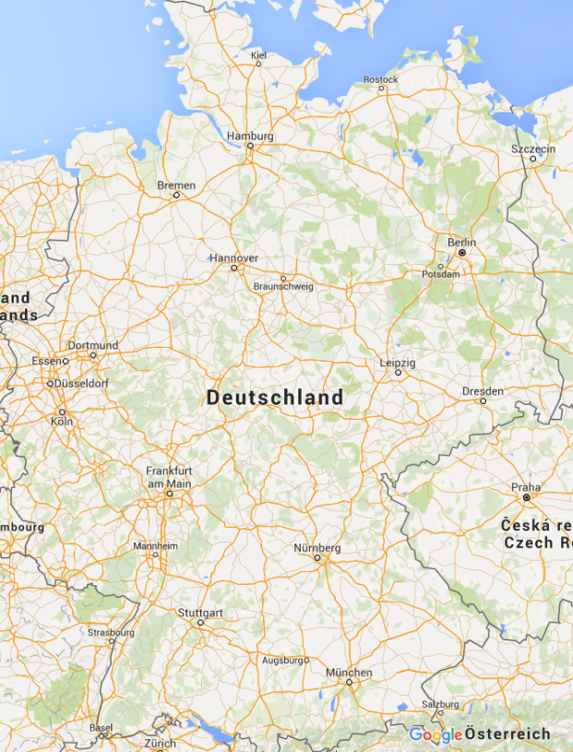
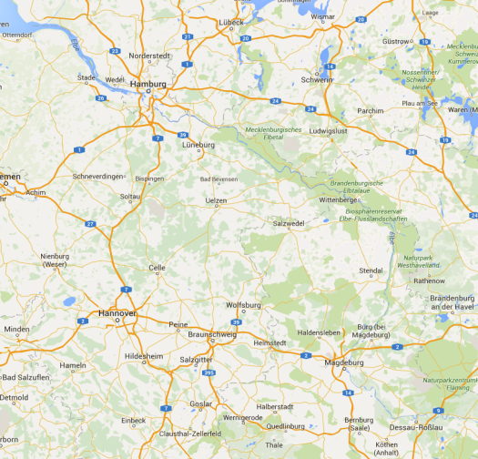
Pilot project 3 - Germany
Digital map with status information on inland waterways in Northern Germany
Focus: Northern German Waterways (e.g. Mittelelandkanal, Elbe-Lateral Canal, River Elbe and Weser, Berliner Kanalgebiet)
Information for shippers
Operating hours
Ship positions and traffic density information
…additional RIS services possible.
Notes:
Digital map with status information on inland waterways conditions, notice to shippers, look operating hours etc. as well as ship positions

Slide 15
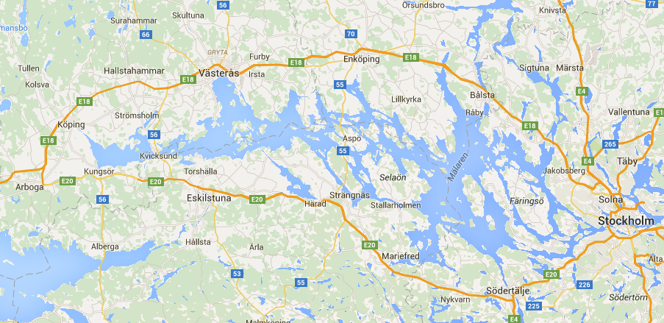
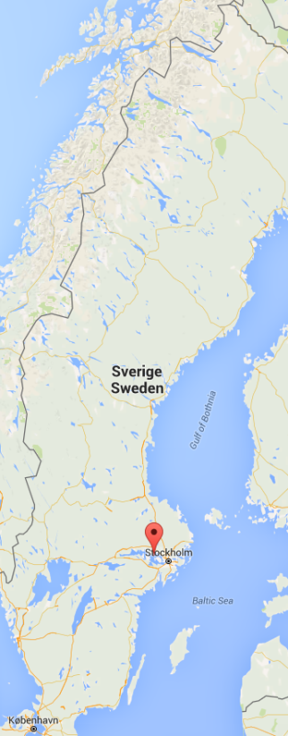
Pilot project 4 – Sweden (Lake Mälaren)
„Dynamic Zone Management System“ and transport shift especially of liquid fuels from road to inland waterways
The system supports at decisions regarding condition of waterways
Eased disposition of inland vessels in Zone 1 and Zone 2 (restrictions regarding draught)
Transport shift of liquid fuels, construction material and recycled products from road to waterways
Development of a sustainable distribution model on Lake Mälaren
Notes:
SE:
o Pilot I = Study on ship transferability assessment
The study will be conducted by the Swedish newly started IWW-specialized, shipping company AWT AB, in cooperation with European actors in:
Ship construction, Inland waterway barging, Classification societies, Other shipping companies, Ship equipment suppliers
→ The study will identify 1-3 vessels suitable for Swedish purposes, and use these as use-cases for the study
o Pilot II = Distribution on inland waterways within the Stockholm & lake Mälaren region
The pilot aims to investigate whether it is possible to shift the distribution of liquid fuels, construction and recycling products from the today on road transportation to a sea- based logistics solution on the inland waterways of Lake Mälaren.
The pilots main goal is to build a commercial and sustainable distribution model that enables a demonstration of IWW-distribution on Lake Mälaren.

Slide 16
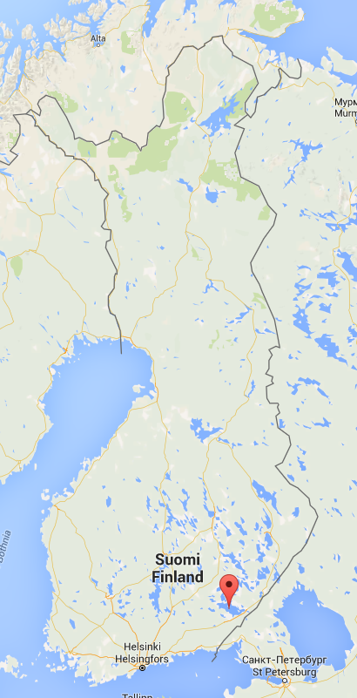
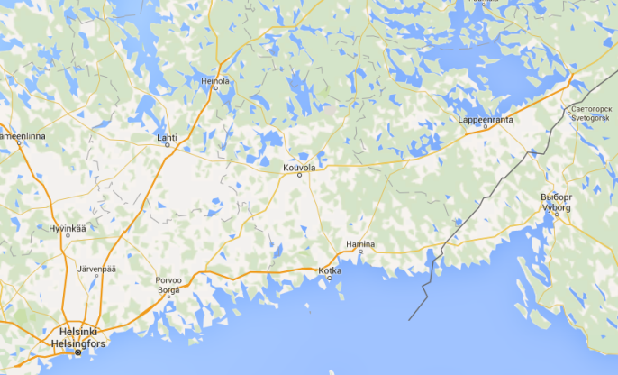
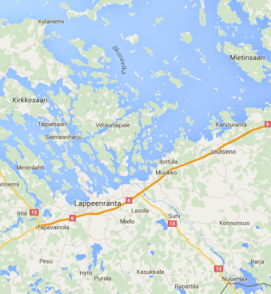
Pilot project 5 – Finland (Lake Saimaa)
Information system for transport optimization of timber products via inland waterways
Via the Saimaa Canal to the Baltic Sea
Challenges due to weather conditions
Long ice season
Delicate flora and fauna
Sensor systems for environment and transport data
Digitalisation
Notes:
Smart navigation system of Saimaa
Navigation in Saimaa area is very challenging due to changes in water level (flooding seasons, drought seasons, length of ice season) in very narrow routes that are in highly environmentally valuable waterways.
Possible solutions: Smart buoy system / Sensor systems for environment data & transport data /Analysing tools for big data collected, Digitalisation – ICT solutions

Slide 17
EMMA appointed to be flagship project
The European Union Strategy for the Baltic Sea Region (EUSBSR) is the first macro-regional strategy in Europe.
It provides an integrated framework for improving:
environmental condition of the sea,
transport bottlenecks and energy interconnections
development of competitive markets across borders
common networks for research and innovation
EMMA was approved as latest flagship in the Policy Area Transport of the EUSBSR.
The project’s flagship status reflects the importance the European Commission attaches to the further development of inland navigation in the Baltic Sea Region!

Slide 18
The EMMA project
Results
There have been individual and efficient transport solutions in the inland waterway and coastal transportation developed and their feasibility demonstrated.
Efficient transport chains including inland waterway and coastal transportation are known and taken into consideration by the consignors.
Strengthened representation of interests in the branch:
Strengthened cooperation of regional and national organisations and associations with European institutions;
The structure of SPCs supports the further development.
A knowledge database is ready for further initiatives.

Slide 19
Thank you for your attention!
Stefan Breitenbach
Head of Project Department
Port of Hamburg Marketing e.V.

